Slide 1


Image Change Detection Using Conditional Copula
Presented by:
Snehal Shirvaiker
Hrushikesh Chavan

Slide 2
Index
1
Objectives
2
Conditional Copula
3
Data Description and Pre-Processing
4
Data Analysis
5
Conclusion

Slide 3
Objectives
To visually identify significant changes in the tumour size of a subject suffering from glioblastoma after treatment.

Slide 4

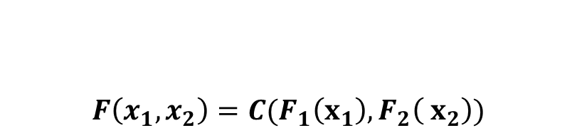
Conditional Copula
Copula
Copula is a function that connects the marginal distribution of two or more random variable to their joint distribution & finds out the dependency between these two variable.
Conditional Copula
Conditional copula describes the dependency structure between two random variables given any one of its distribution. It specifies how the joint distribution of the two distribution changes with the marginal distribution of any one of its random variable.
$$F\left(x_{1},x_{2}\right)=C(F_{1}\left(x_{1}\right),F_{2}\left( x_{2}\right))$$
Abe Sklar

Slide 5
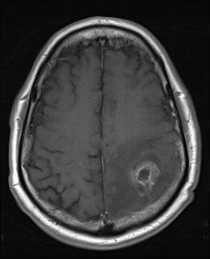
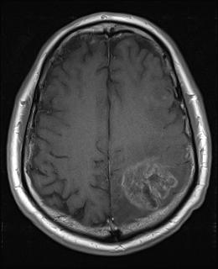
Data Description
Subject 1
20 subjects
3D data
Diagnosed with glioblastoma
Nifti format
2D data => Dicom
2 scans for each subject
1 scan -> 24 slices
We selected only 1 of the 24 slices
The time between the scans are subjective
T1
T2

Slide 6
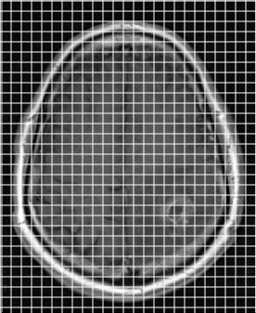
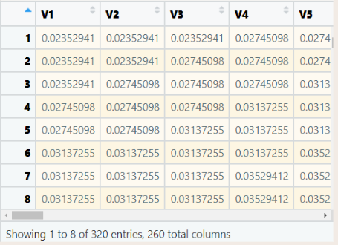
Data Pre-Processing
NIfTI (3D)
Converting into pixel intesity matrix
DICOM (2D)
320*260 Dimension
JPG
Converting the matrix into a vector of 320*260=83200 length vector.

Slide 7
Conditional Copula Modelling Dependency Between Two Images
X
Vector of pixel intensities at time T1
Y
Vector of pixel intensities at time T2
which is after treatment
As X and Y are dependent, we find the dependency structure between them.
Therefore we use copula to model the dependency and find out the conditional copula Y|X.

Slide 8
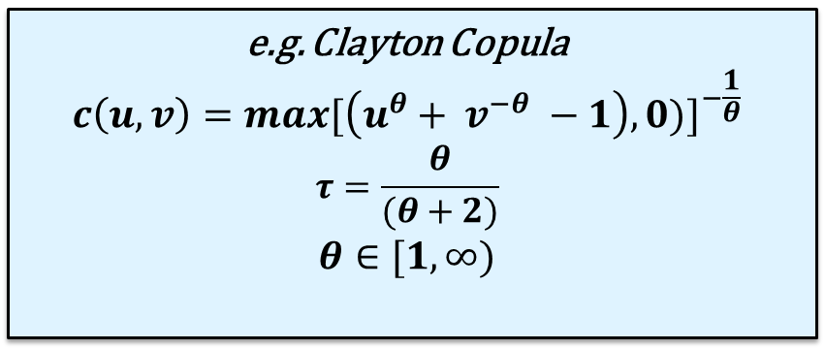
Conditional Copula Modelling Dependency Between Two Images
Used 5 types of copula namely: Clayton, Frank, Gumbel, Student T’s, Gaussian
e.g. Clayton Copula
$$c\left(u,v\right)={max⁡[\left(u^{θ}+ v^{−θ} −1\right),0)]}^{−\frac{1}{θ}}$$
$$τ=\frac{θ}{(θ+2)}$$
$$θ∈[1,∞)$$

Slide 9
Data Analysis Conditional copula
 | Clayton | Frank | Gumbel | Student T’s | Gaussian
Tau | 0.91 | 0.89 | 0.94 | 0.96 | 0.97
Parameter | 19.36 | 35 | 17 | 1,2 | 1
Log | 1164.11 | 664.03 | 959.79 | 1164.83 | 1162.08
AIC | -2326.22 | -1326.06 | -1917.58 | -2325.66 | -2322.15
BIC | -2316.89 | -1316.73 | -1908.25 | -2307 | -2312.82
Parameter
Estimation
Model
Selection
From AIC BIC value we select Clayton as a best-fit copula for further analysis.

Slide 10
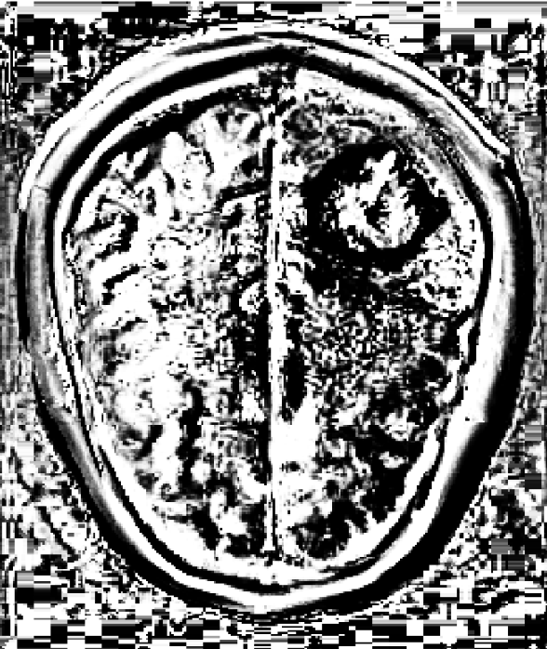
Data Analysis Modelling Dependency Between Two Images
We use the modelled clayton copula with given parameters for estimating the dependency of Y|X
That is we get a conditional distribution of image 2 | image 1
Pixel intensity vector of Y|X
Pixel intensity matrix

Slide 11
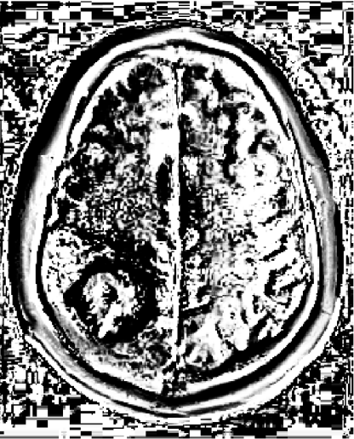
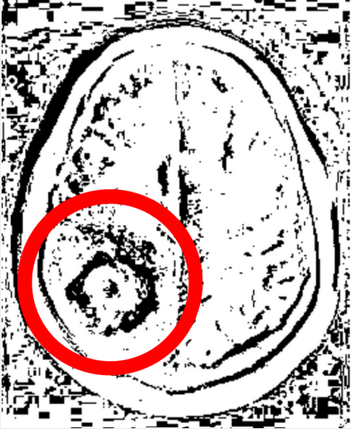
Thresholding
Thresholding corresponds to setting all values below a threshold to 1, all above to 0.
E.g. Threshold at 92 %

Slide 12
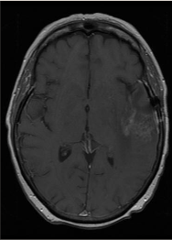
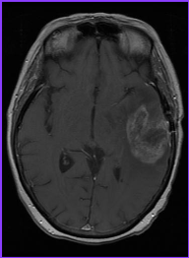
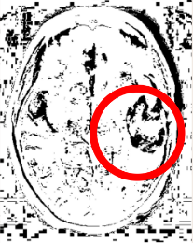
Subject 2
Conditional Copula method (Y|X)
Image 1 (X)
Image 2 (Y)

Slide 13
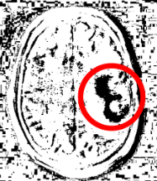
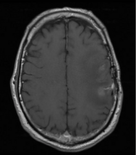
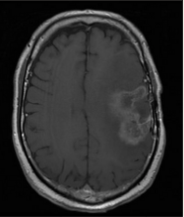
Subject 3
Conditional Copula method (Y|X)
Image 1 (X)
Image 2 (Y)

Slide 14
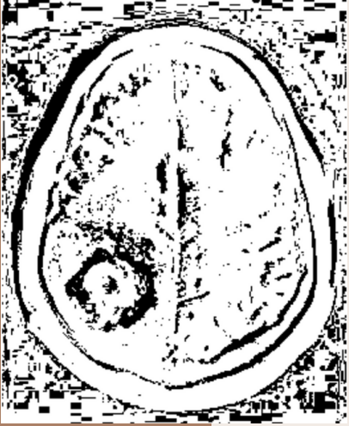
Conclusion
Conditional copula model explains the dependence of Y on X, which is why it could distinctly show the change between the two images.

Slide 15

Future Scope
Our results can further be used to compare with other ML models.
This model can be applied to 3D data which could give more accurate results.
This method can also be applicable to geographical studies to detect change in the land after a disaster.
Can be applied to any type of scans SAR/CAT/MRI etc.

Slide 16
References
Data set: https://www.kaggle.com/datasets/andrewmvd/brain-tumor-progression
Conference Paper, November 2008: Image Change Detection using Copulas, ZENG Xuexing and Tariq S DURRANI. Department of Electronic &Electrical Engineering. University of Strathclyde.
Conditional Copulas for Change Detection in Heterogeneous Remote Sensing Images. Grégoire Mercier, Senior Member, IEEE, Gabriele Moser, Member, IEEE, and Sebastiano B. Serpico, Senior Member, IEEE

Slide 17
Thank you

